Slide 1
SQLdm Dallas
Plan of Record
September 24, 2008
www.idera.com

Slide 2
Version History
Name | Version | Date | Comments
Trent Miskelly | 1 | 9/11/2008 | First draft
Trent Miskelly | 2 | 9/24/2008 | Incorporated review comments
www.idera.com

Slide 3
Overview
Project
  Version: 6.0
  Codename: Dallas
  Theme: Capture the Enterprise
  Beta: TBD
  GA: Q2 2009
Team
  Product Manager: Heather Sullivan
  Dev Lead: Trent Miskelly
  Doc Lead: Marlowe Wakeman
  QA Lead: Charles Chandler
www.idera.com

Slide 4
The Plan
Capture the Enterprise
  Improve features that cause management bottlenecks
    Alert Rules & Actions, simplifying SQLdm configuration
    Enterprise Management Solution Integration
    SQLdm Change Auditing
  Introduce feature that appeal to enterprise customers
    Capacity Planning Reports (including Forecasting)
    Database Mirror Monitoring
    Wait and Queue Monitoring
    PowerShell Integration
  But we’re not just going to give this away…
www.idera.com

Slide 5
Introducing Two Editions of SQLdm
SQLdm Standard
  Includes all features available in 5.6
  Includes existing feature enhancements and new features that appeal to our broader user base (ex. SQL Event Log Alerts)
  Pro features will be teased to entice upgrades
SQLdm Pro
  Why give it away when we’re adding value?
  Includes features that appeal to customers using new SQL Server enhancements (ex. Database Mirroring)
  Includes “enterprise” features for large environments (ex. PowerShell Integration)
www.idera.com

Slide 6
Packaging & Licensing
Both editions will be available in the same package
  Actually, they’re the same binaries!
License key will enable/disable Pro features
  Version licenses cannot be mixed; either Pro feature are enabled for all monitored servers or none
  Trial keys will enable Pro features, which should entice users to think twice before going with Standard in production
This model should minimize R&D cost
  We’re not developing/testing separate products, simply hiding or exposing features
www.idera.com

Slide 7
6.0 Features
Feature | Standard | Pro
Alert Rules & Actions | X | X
Reports 2.0 | X | X+
Database Mirror Monitoring |  | X
Wait and Queue Monitoring |  | X
Query Wait Monitoring | X | X
Enterprise Management Solution Integration | X | X
Cross Domain Support | X | X
PowerShell Integration |  | X
SQL Event Log Alerts | X | X
SQLdm Change Auditing | X | X
X+ indicates that the feature is extended beyond that offered in the Standard version.
www.idera.com

Slide 8
Alert Rules
Problem
  Alert configuration is too complex and time consuming
  Alerts must be configured per server
  No birds-eye view of current alert configuration
  No ability to create alert templates to apply to groups of servers
Solution
  Allow users to tag servers (i.e., ServerA belongs to Accounting, Development)
  Allow alert rules to be configured like our existing Notification Rules
  Allow alert rules to be defined across servers (i.e., raise a critical alert for ServerA or ServerB if CPU Usage reaches 90%)
  Allow alert rules to be defined by server tags (i.e., raise a critical alert for any Production server if CPU Usage reaches 90%)
Opportunity
  This is a very compelling feature for organization monitoring 10+ servers
  Shows enterprises that we hear them and are addressing their needs
www.idera.com

Slide 9
Alert Actions
Problem
  Existing notification providers do not provide for automated alert resolution
  Customers want to run scripts or applications when alerts are raised
  Customers had the ability to run programs in SQLdm 4.x
Solution
  Add the ability to run SQL Server Agent Jobs when an alert is raised
  Add the ability to run SQL script or statement when an alert is raised
  Add the ability to run an program (exe, cmd, bat) when an alert is raised
  Rebrand “Notifications” as “Actions” to indicate new scope
Opportunity
  This feature will satisfy a number of outstanding customer requests
  This feature enables EMS Integration
www.idera.com

Slide 10
Reports 2.0
Problem
  Our existing reports are not sufficient for historical analysis
  Our existing reports are just data dumps and are not focused on real world problems
  Customers want to forecast capacity issues based on historical trends
Solution
  Redesign reports to focus on real world problems so the data has context
  Build reports that forecast future database and table growth based on historical trends
  Build reports using Reporting Services so customers can host them on a Reporting Services Server if so desired
Opportunity
  Our reports are the weakest feature of 5.x, and they were the most used feature in 4.x… getting this right is very important and completeness is essential
  The Capacity Forecasting reports will only be available in the Pro version
  This is the most significant new feature of 6.0
www.idera.com

Slide 11
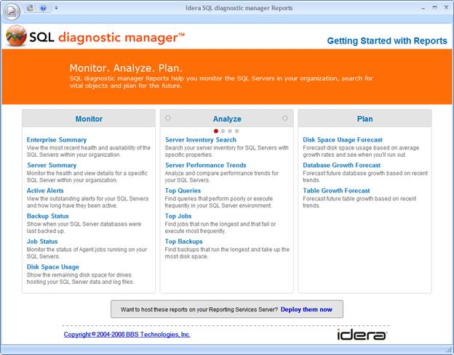
Reports 2.0 – Launch Pad
www.idera.com

Slide 12
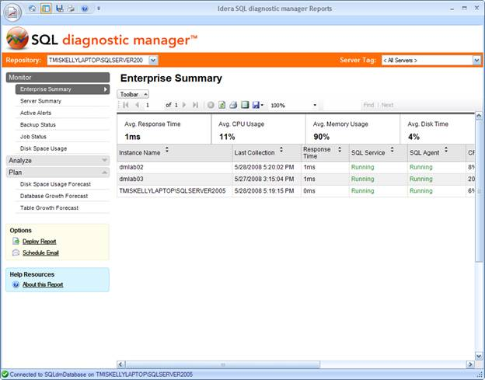
Reports 2.0 – Report View
www.idera.com

Slide 13
Database Mirror Monitoring
Problem
  Many of our customers are implementing Database Mirroring in their environments and we offer no monitoring solution
  Monitoring database failover is critical
Solution
  Add a real-time view for monitoring database mirroring environments, using Charles Schwab’s monitoring solution as the basis
  Raise alerts when database failover occurs
Opportunity
  Database Mirroring is becoming a very popular trend among SQL Server DBAs and our customers, so this is a critical feature
  Database Mirroring is supplanting Replication, so we should invest in monitoring mirroring as opposed to improving our replication monitoring feature
  This feature will available in the Pro version only
www.idera.com

Slide 14
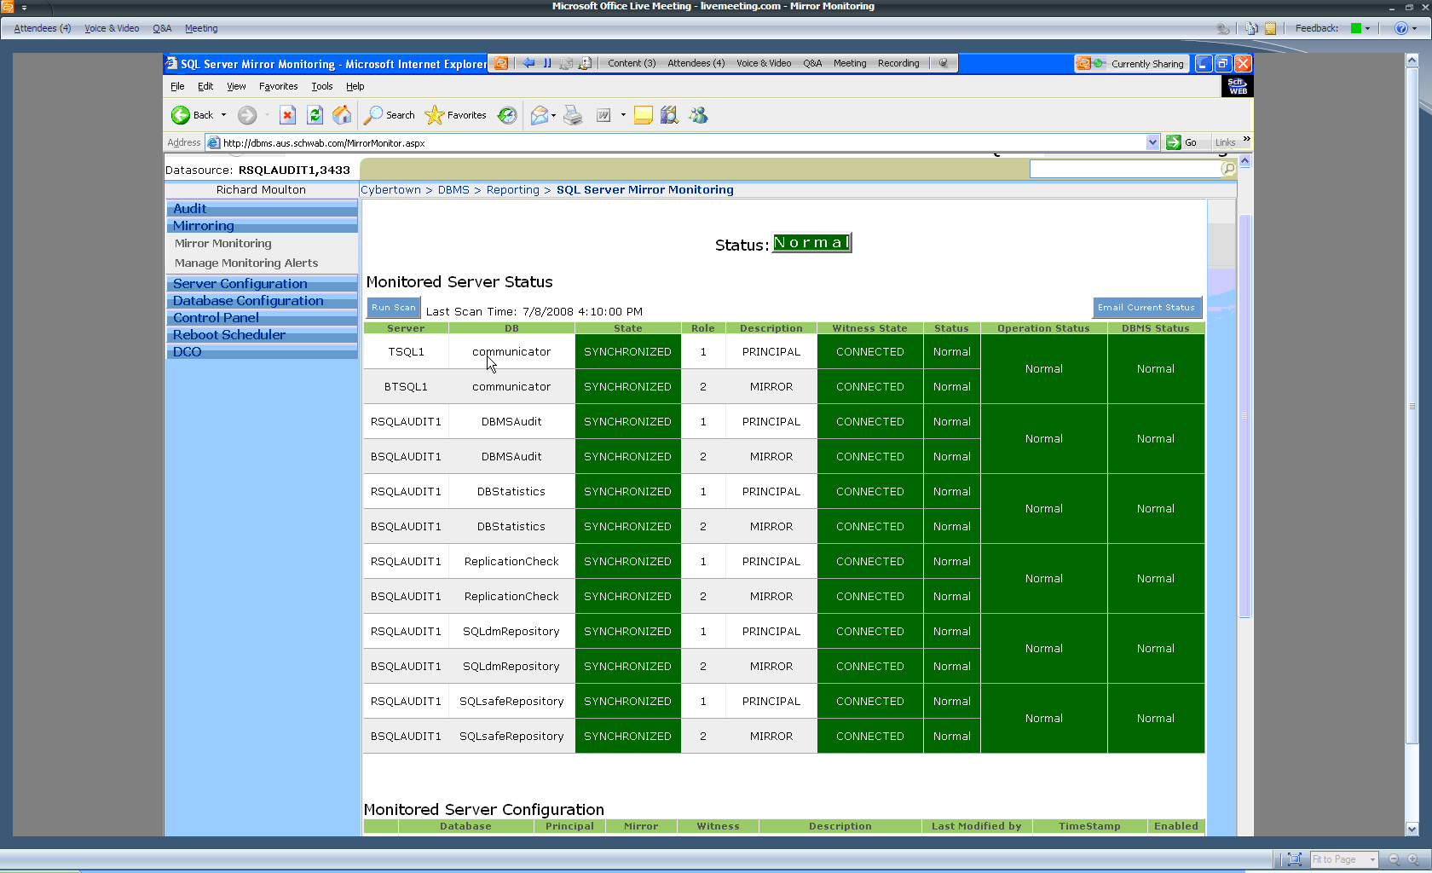
DMM – Charles Schwab Solution
www.idera.com

Slide 15
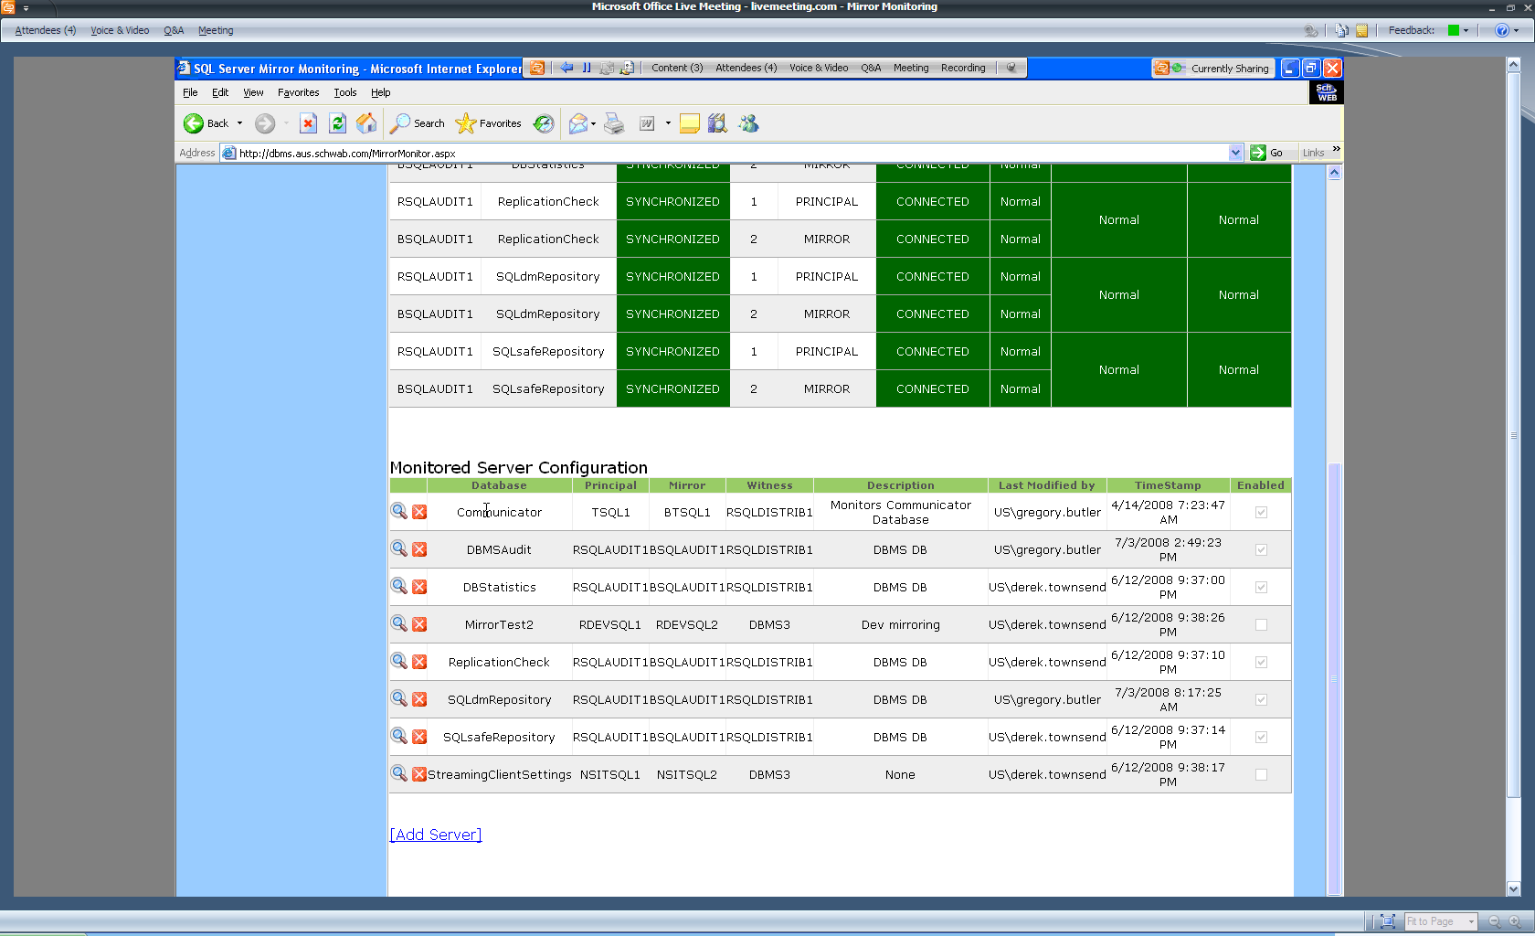
DMM – Charles Schwab Solution
www.idera.com

Slide 16
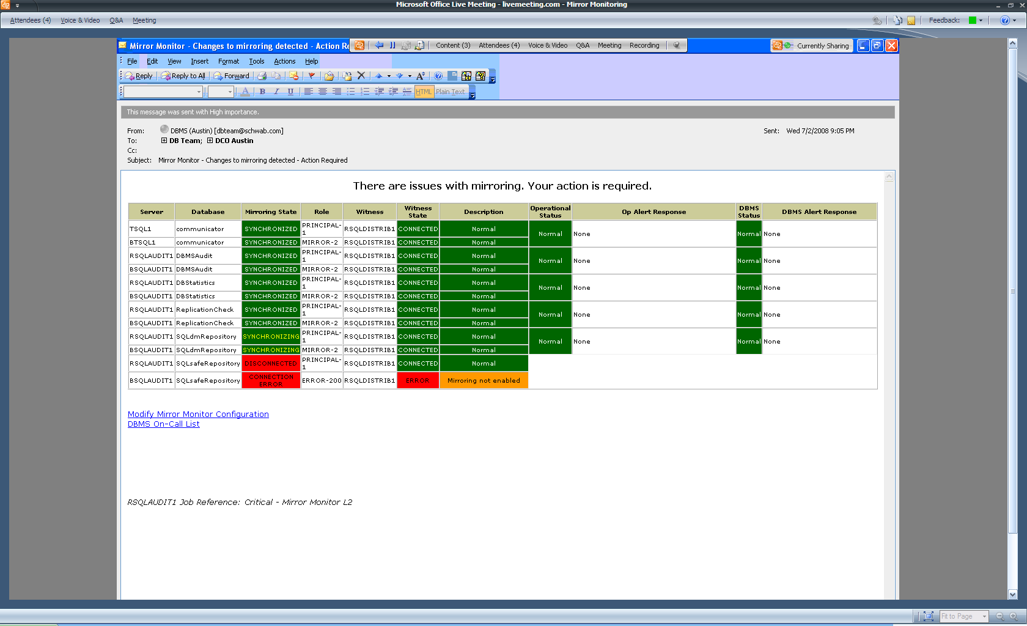
DMM – Charles Schwab Solution
www.idera.com

Slide 17
Wait and Queue Monitoring
Problem
  Where is SQL Server spending it’s time waiting?
  What resources are under contention in a SQL Server environment?
Solution
  Add a new Wait & Queue view that allows DBAs to monitor resource contention
  Correlate waits with queue counters to give context (ex. if the total number of lock requests was 10 million, perhaps 1000 waits is insignificant)
  Add alerts to indicate when wait problems are occurring (ex. Average Wait Time is increasing, Signal Wait Time is increasing)
Opportunity
  Wait monitoring is becoming a very popular trend among SQL Server DBAs and our customers, so this is a critical feature, especially to our Pro users
  This feature will available in the Pro version only
www.idera.com

Slide 18
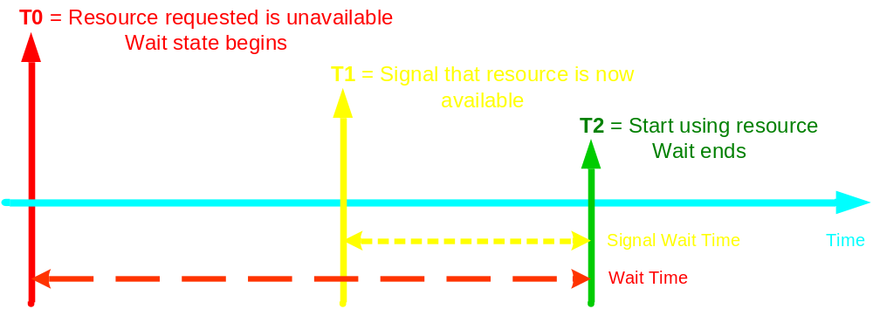
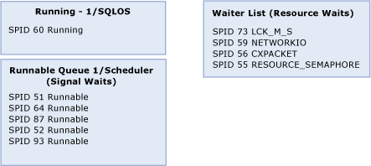
WQM – Wait & Queues Illustrated
www.idera.com

Slide 19
Query Wait Monitoring
Problem
  Where are queries spending their time while executing?
  What resources are queries waiting on (resource contention)?
Solution
  Add new column to Query Monitor view that indicates what portion of query execution time is spent waiting vs. running
  Add a new view that allows users to drill down to the query level to the resources that a query is waiting on
Opportunity
  Wait monitoring is becoming a very popular trend among SQL Server DBAs and our customers, so this will be a very compelling feature
  This feature goes hand-in-hand with Wait & Queue Monitoring
  This may be a SQL Server 2008 feature depending on how we collect this data (Extended Events are only available in SQL Server 2008)
www.idera.com

Slide 20
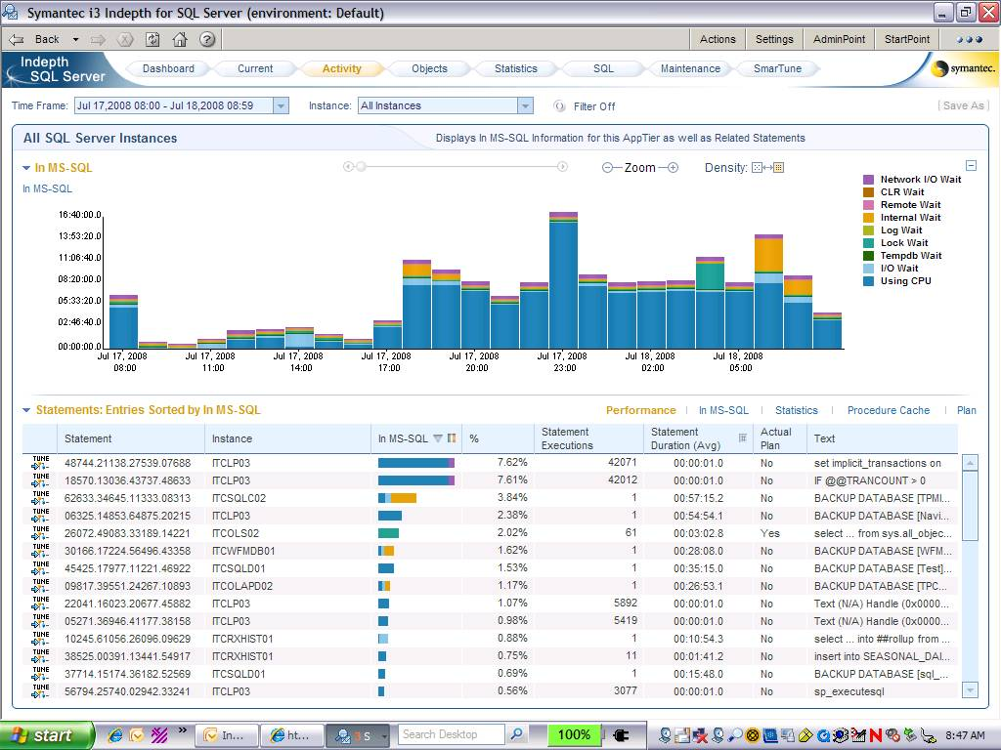
QWM – Example Overview
www.idera.com

Slide 21
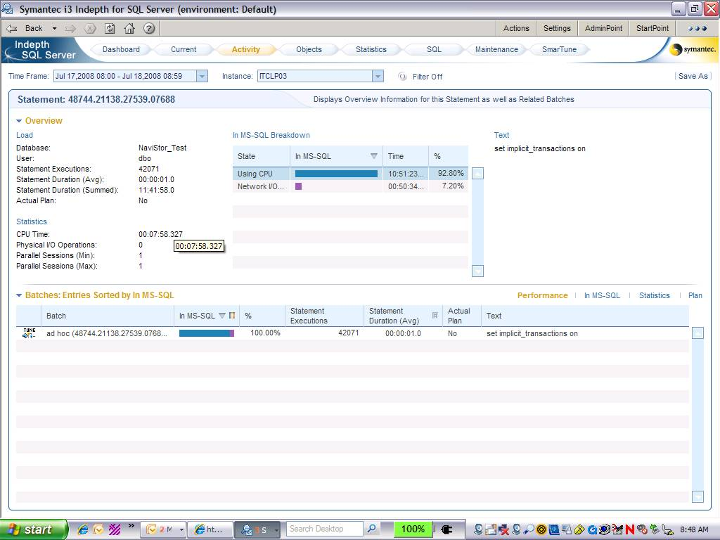
QWM – Example Query View
www.idera.com

Slide 22
EMS Integration
Problem
  Larger organizations need SQLdm alerts to integration with central ticketing systems that are shared among operational departments
  The current SQLdm infrastructure makes it very difficult to offer a EMS integration solution
  In SQLdm 4.x, customers could run a program when an alert was raised; this option doesn’t exist in 5.x
Solution
  Leverage the new “run a program” alert action to call into EMS ticketing systems
  The alert action will allow any program to be run and parameters can be customized, unlike 4.x
Opportunity
  This feature is critical to our larger customers and has been requested by many existing customers and prospects
  This solution has been validated with a number of our existing customers
  Robustness of this feature is important
www.idera.com

Slide 23
Cross Domain Support
Problem
  Customers want to run the desktop client in separate, non-trusted domains from the management/collection service
  Customers want to specify alternative Windows credentials for the Collection Service to monitor with other than those that the service is running as
Solution
  Do not require authenticated connections between the desktop client and management service; this connection should be managed at the port level
  Allow users to specify alternative Windows credentials with which to monitor SQL Servers; these credentials will be impersonated by the Collection Service when running scheduled and real-time collections
Opportunity
  The need to host desktop clients and services in separate domains is becoming critical to some of our larger customers
  Collection Service impersonation may get deferred
www.idera.com

Slide 24
PowerShell Integration
Problem
  Customers have requested to have the ability to automate SQLdm tasks such as adding/removing servers or configuring maintenance windows
Solution
  Expose management objects via PowerShell to begin offering automation capabilities in SQLdm
Opportunity
  This feature will be available in the Pro version only
  This feature is critical for justifying a Pro version
  PowerShell is getting a lot of attention, and since we’re releasing products for it, we should be offering integration where it makes sense
  We will likely scope this feature to management level tasks only in v1, exposing data level operations in a future release
www.idera.com

Slide 25
SQL Event Log Alerts
Problem
  Many SQL Server and database application errors are reported in the SQL Server and Agent event logs, but we offer no way to gets alerts on these errors
Solution
  Add new alert rule that will raise an alert if an event is logged to the SQL Server or Agent event log that contains specified text (ex. raise a critical alert of an event contains “SSPI handshake failed”)
  Add new alert rule that will raise an alert if an event is logged to the SQL Server or Agent event log with a specified severity or range or severities (ex. raise an critical alert if an event with severity 11-20 is written)
Opportunity
  The event log is one of the first places a SQL Server DBA will look to discover or diagnose SQL Server problems; our lack of this feature is a big miss at this point and our customers have let us know about it
www.idera.com

Slide 26
SQLdm Change Auditing
Problem
  Currently, it is difficult, if not impossible to determine system configuration changes and actions performed in SQLdm
  Organizations with multiple DBAs have to trackback mechanism to correlate changes with an individual
Solution
  Add an audit log to the metrics repository that tracks changes and actions performed in SQLdm (ex., metric configuration changes, start/stop jobs)
  Add an audit view, if not available in alerts view
  Nice to have:
    Add alerts that can be raised when certain audit conditions occur
Opportunity
  This feature is becoming critical to our larger customers and is requested by prospects
  Completeness of this feature is important
www.idera.com

